Slide 1

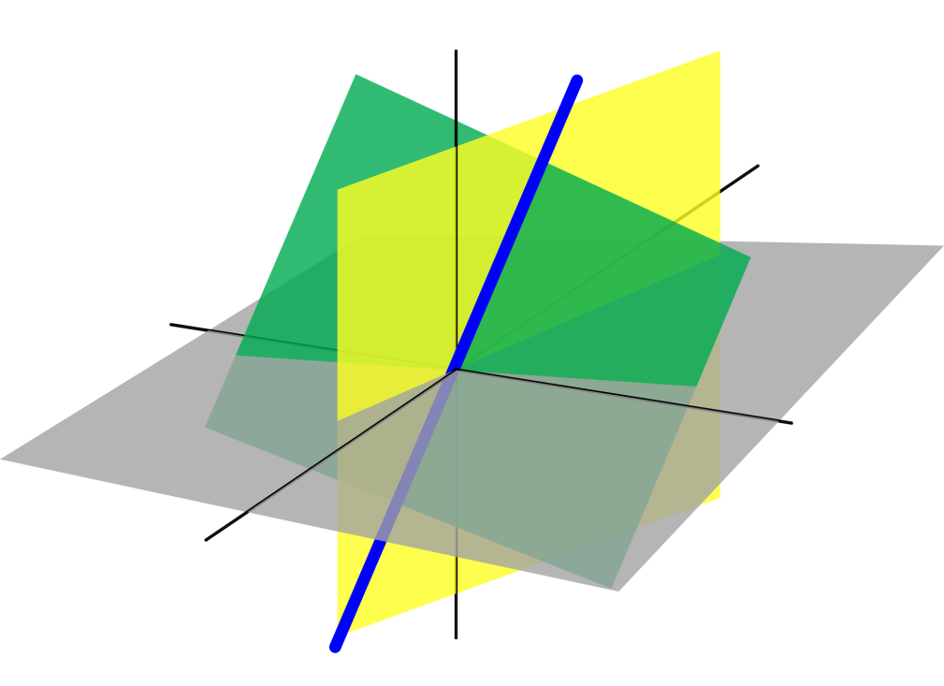
Azərbaycan Dövlət Neft və Sənaye Universiteti
Analytic Geometry

Slide 2
Dot Product of Vectors

Slide 3
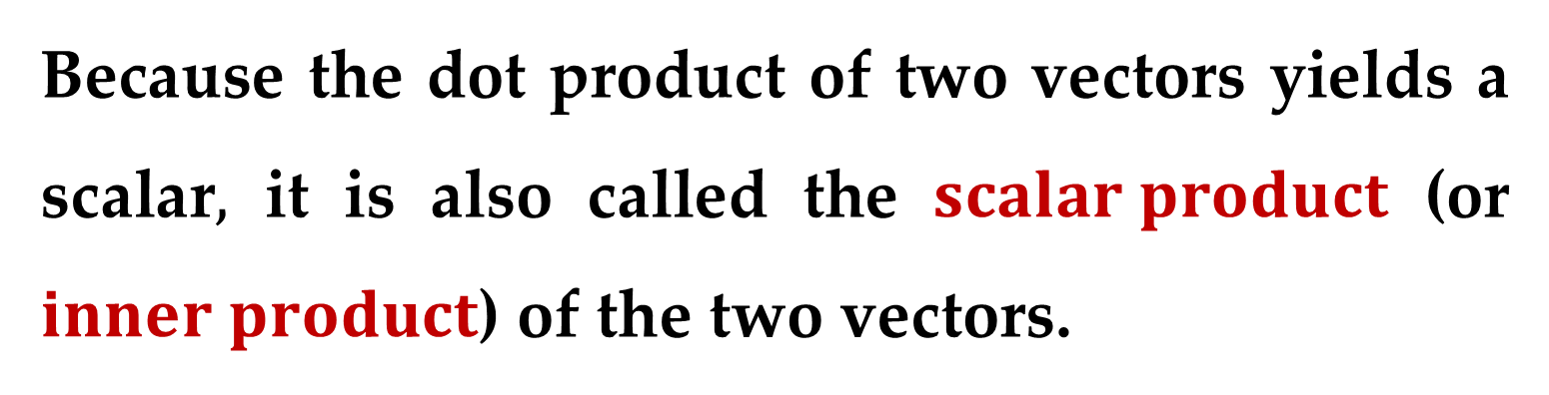
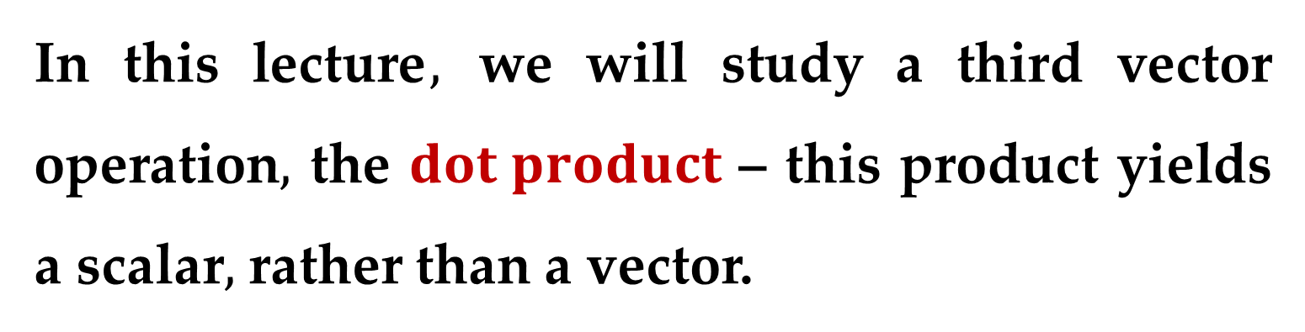
So far we have studied two operations with vectors — vector addition and multiplication by a scalar — each of which yields another vector.
In this lecture$,$ we will study a third vector operation$,$ the $dot product$ – this product yields a scalar$,$ rather than a vector.
Because the dot product of two vectors yields a scalar$,$ it is also called the $scalar product$ (or $inner product$) of the two vectors.

Slide 4
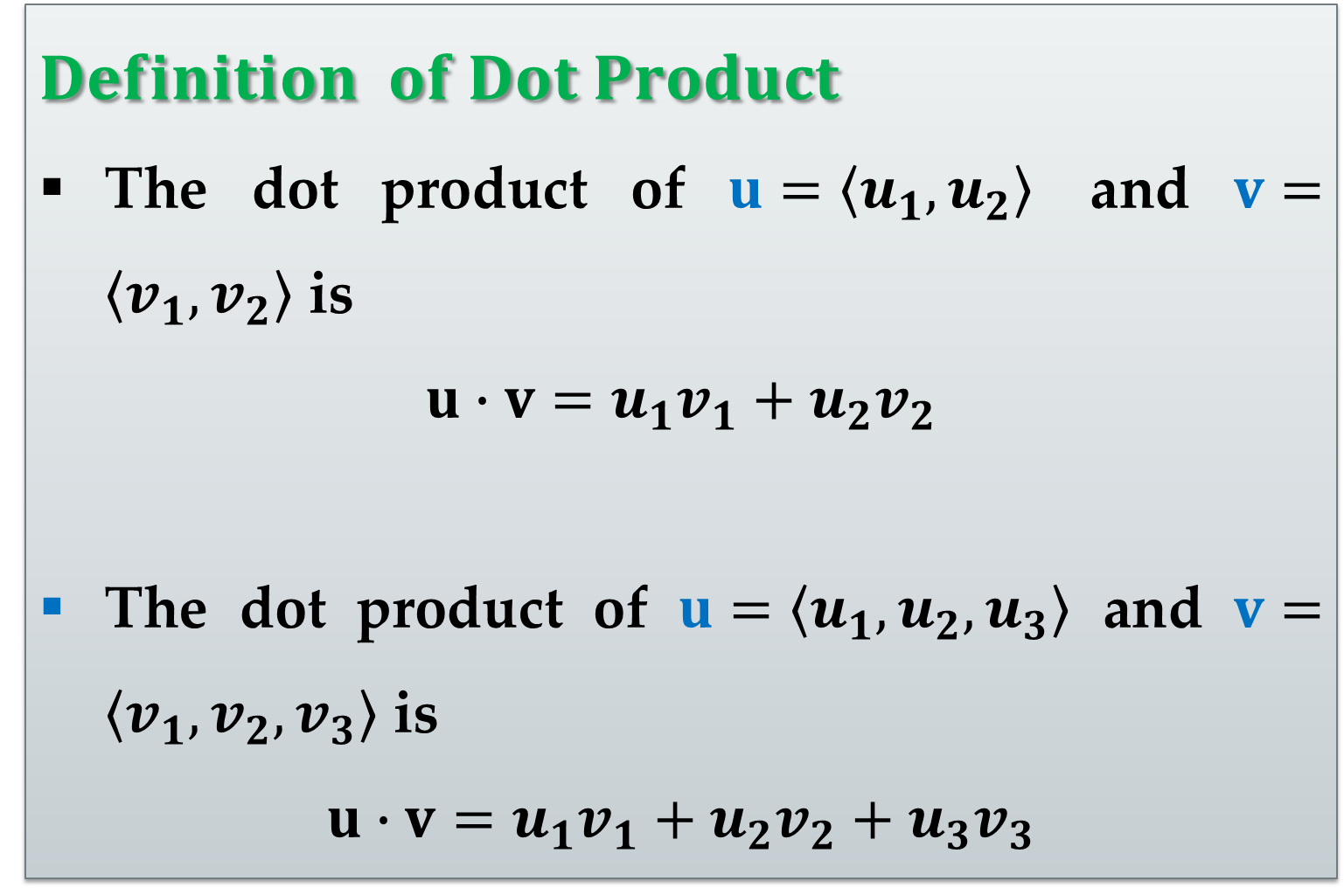
$$Definition of Dot Product$$
The dot product of $u=\left\langle u_{1},u_{2}\right\rangle$ and $v=\left\langle v_{1},v_{2}\right\rangle$ is
$$u∙v=u_{1}v_{1}+u_{2}v_{2}$$
The dot product of $u=\left\langle u_{1},u_{2},u_{3}\right\rangle$ and $v=\left\langle v_{1},v_{2},v_{3}\right\rangle$ is
$$u∙v=u_{1}v_{1}+u_{2}v_{2}+u_{3}v_{3}$$

Slide 5
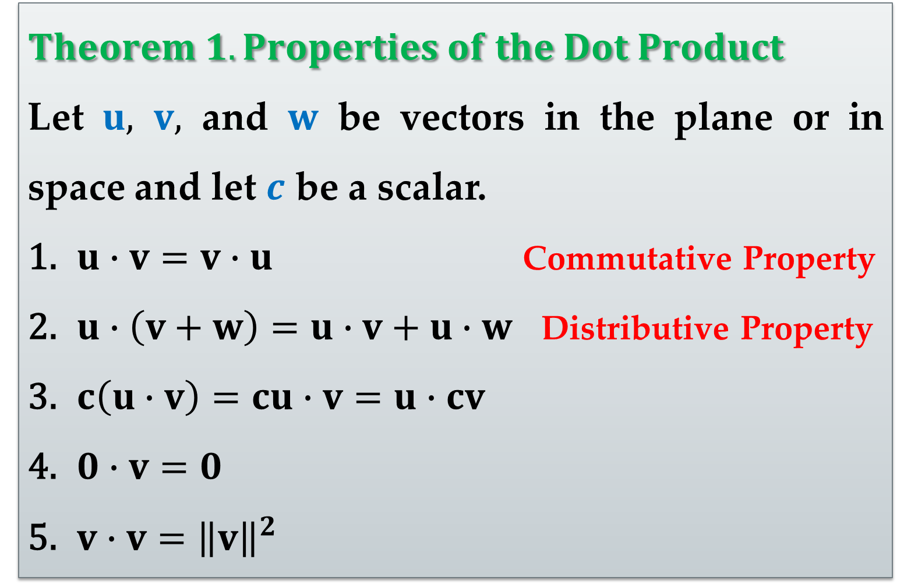
$$Theorem 1. Properties of the Dot Product$$
Let $u, v,$ and $w$ be vectors in the plane or in space and let $c$ be a scalar.
$u∙v=v∙u$ Commutative Property
$u∙\left(v+w\right)=u∙v+u∙w$ Distributive Property
$c\left(u∙v\right)=cu∙v=u∙cv$
$0∙v=0$
$v∙v={\left\|v\right\|}^{2}$

Slide 6
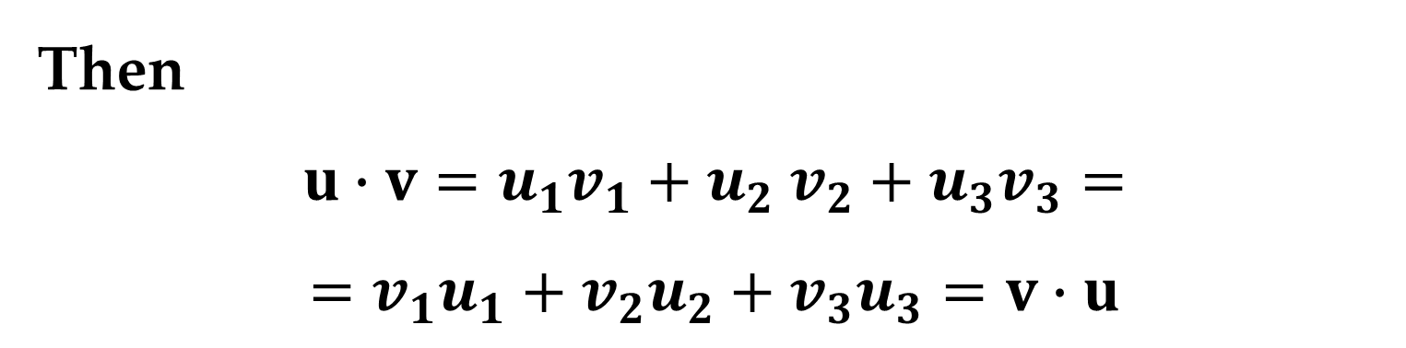
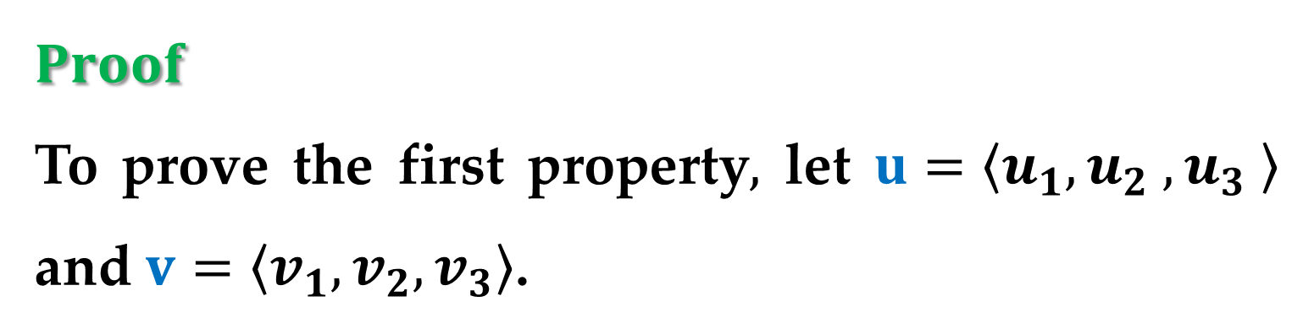
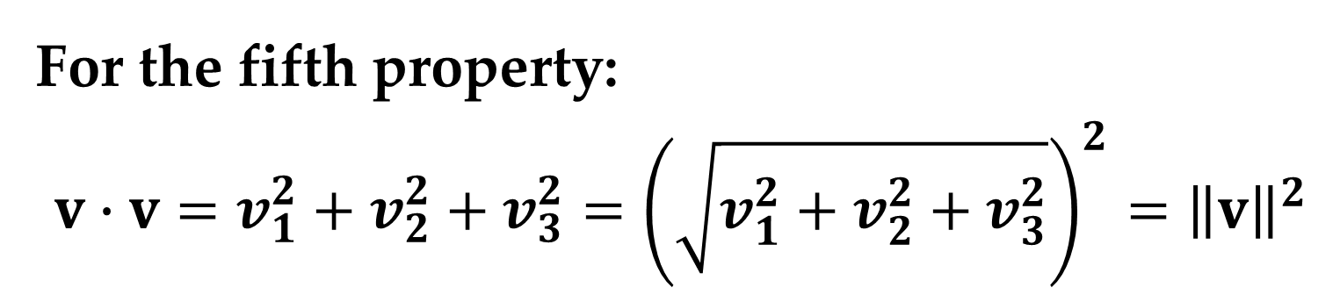
$$Proof$$
To prove the first property$,$ let $u=\left\langle u_{1},u_{2} ,u_{3} \right\rangle$ and $v=\left\langle v_{1},v_{2},v_{3}\right\rangle$.
Then
$$u∙v=u_{1}v_{1}+u_{2} v_{2}+u_{3}v_{3}=$$
$$=v_{1}u_{1}+v_{2}u_{2}+v_{3}u_{3}=v∙u$$
For the fifth property:
$$v∙v=v_{1}^{2}+v_{2}^{2}+v_{3}^{2}={\left(\sqrt{v_{1}^{2}+v_{2}^{2}+v_{3}^{2}}\right)}^{2}={\left\|v\right\|}^{2}$$

Slide 7
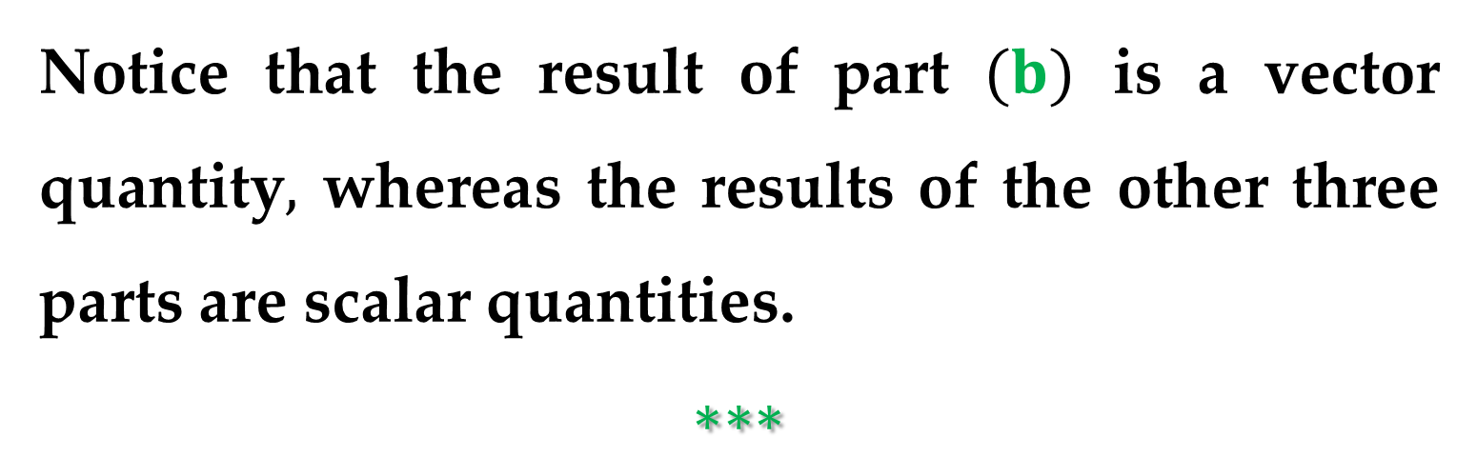
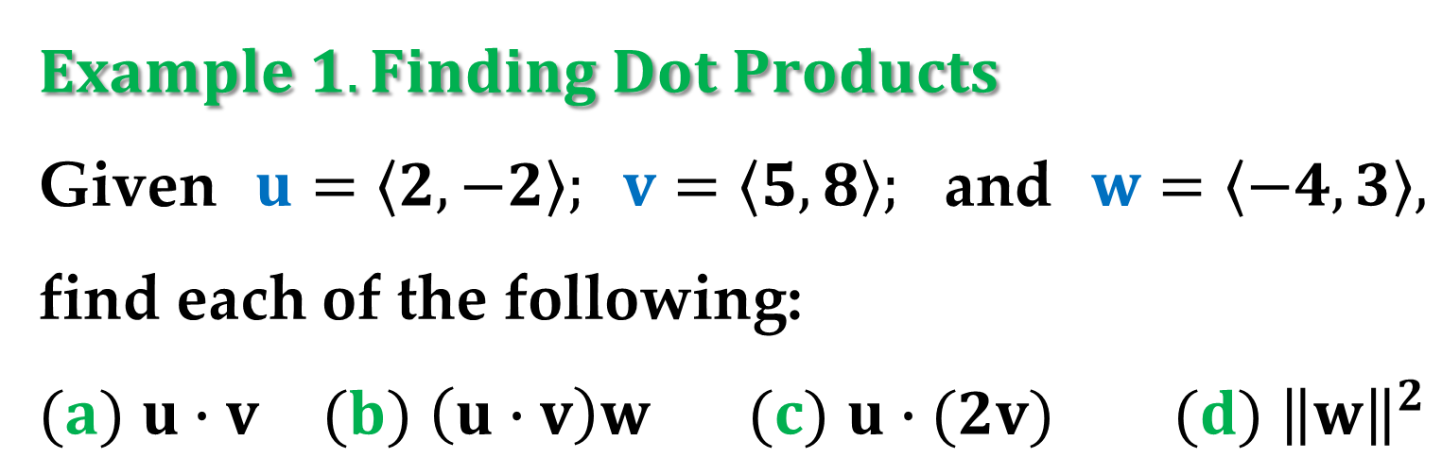
$$Example 1. Finding Dot Products$$
Given $u=\left\langle 2,−2\right\rangle ; v=\left\langle 5,8\right\rangle ;$ and $w=\left\langle −4,3\right\rangle ,$ find each of the following:
$(a)$ $u∙v$ $(b)$ $\left(u∙v\right)w$ $(c)$ $u∙(2v)$ $(d)$ ${\left\|w\right\|}^{2}$
Notice that the result of part $(b)$ is a vector quantity$,$ whereas the results of the other three parts are scalar quantities.
$$∗∗∗$$

Slide 8
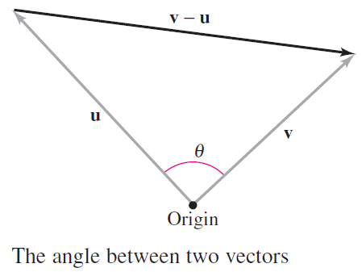
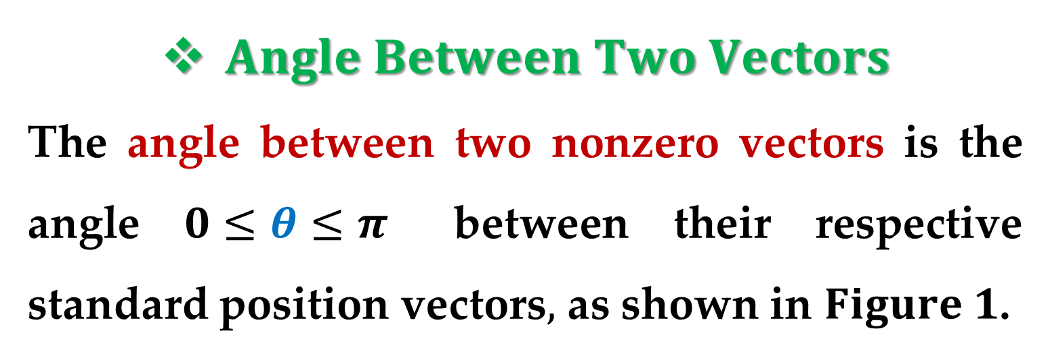
$Angle Between Two Vectors$
The angle between two nonzero vectors is the angle $0≤θ≤π$ between their respective standard position vectors$,$ as shown in $Figure 1$.

Slide 9
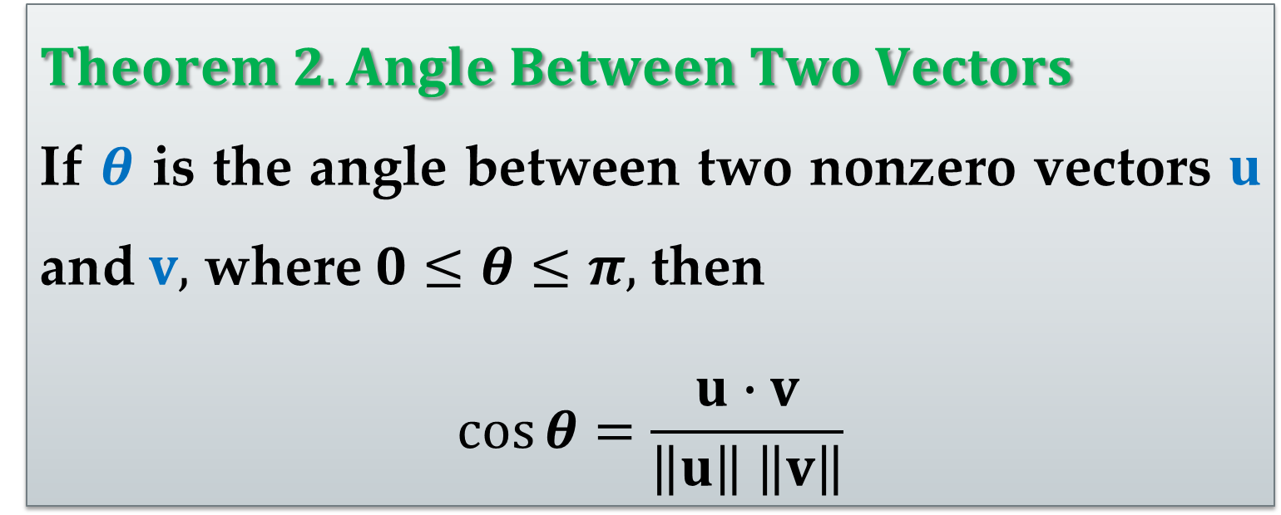
Note that the angle between the zero vector and another vector is not defined here.
The next theorem shows how to find this angle using the dot product.
$$Theorem 2. Angle Between Two Vectors$$
If $θ$ is the angle between two nonzero vectors $u$ and $v,$ where $0≤θ≤π,$ then
$$\cos{θ}=\frac{u∙v}{\left\|u\right\| \left\|v\right\|}$$

Slide 10
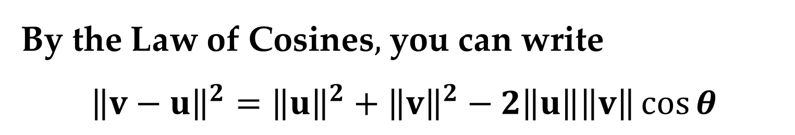
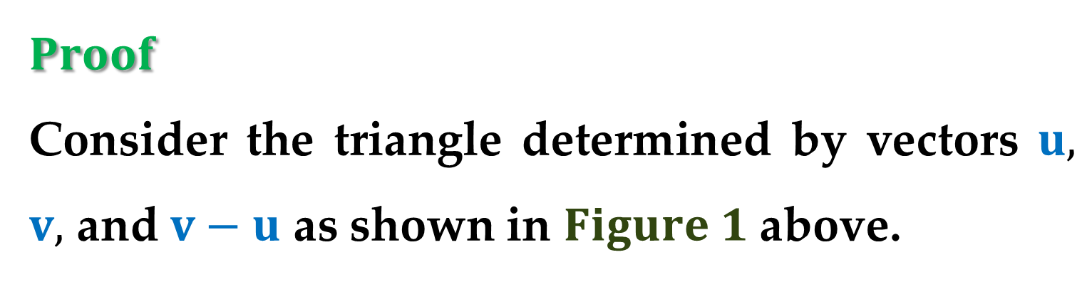
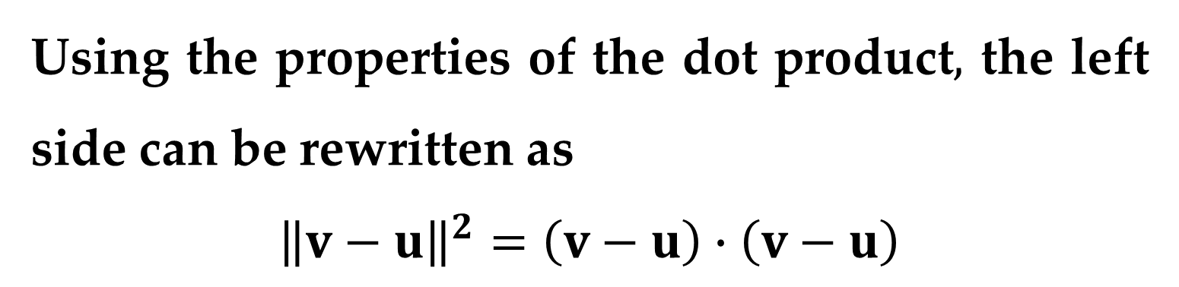
$$Proof$$
Consider the triangle determined by vectors $u,$ $v,$ and $v−u$ as shown in $Figure 1$ above.
By the Law of Cosines$,$ you can write
$${\left\|v−u\right\|}^{2}={\left\|u\right\|}^{2}+{\left\|v\right\|}^{2}−2\left\|u\right\|\left\|v\right\|\cos{θ}$$
Using the properties of the dot product$,$ the left side can be rewritten as
$${\left\|v−u\right\|}^{2}=\left(v−u\right)∙\left(v−u\right)$$

Slide 11

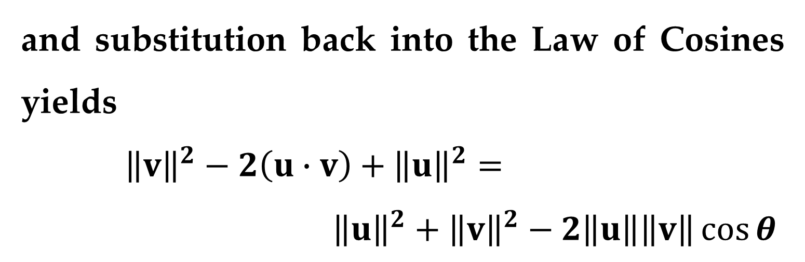
$$Proof (continued)$$
$$…=\left(v−u\right)∙v−\left(v−u\right)∙u$$
$$…=v∙v−u∙v−v∙u+u∙u$$
$$…={\left\|v\right\|}^{2}−2\left(u∙v\right)+{\left\|u\right\|}^{2}$$
and substitution back into the Law of Cosines yields
${\left\|v\right\|}^{2}−2\left(u∙v\right)+{\left\|u\right\|}^{2}=$
${\left\|u\right\|}^{2}+{\left\|v\right\|}^{2}−2\left\|u\right\|\left\|v\right\|\cos{θ}$

Slide 12


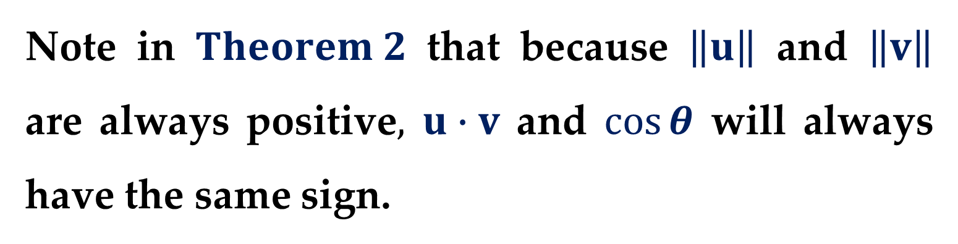
$$Proof (continued)$$
$$−2 u∙v=−2\left\|u\right\|\left\|v\right\|\cos{θ}$$
$$\cos{θ}=\frac{u∙v}{\left\|u\right\| \left\|v\right\|}$$
Note in $Theorem 2$ that because $\left\|u\right\|$ and $\left\|v\right\|$ are always positive$,$ $u∙v$ and $\cos{θ}$ will always have the same sign.

Slide 13
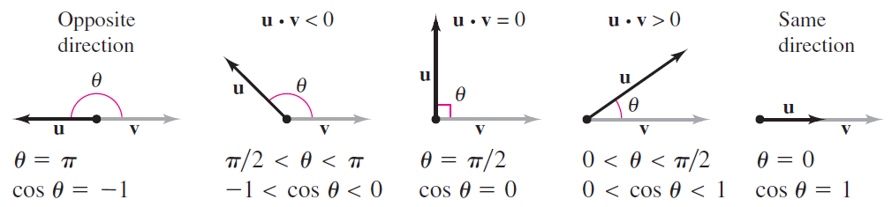
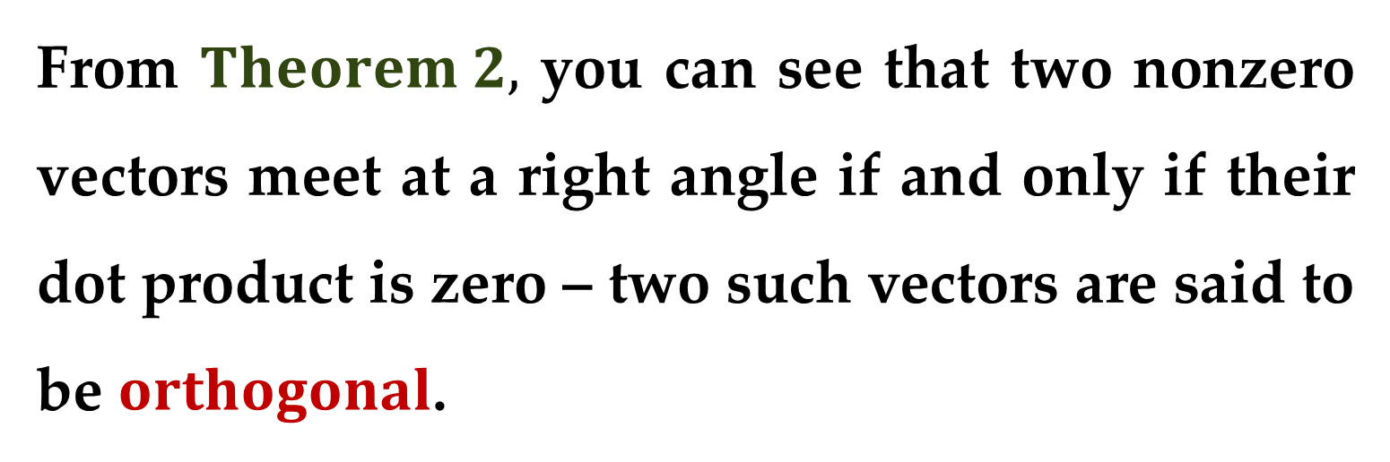
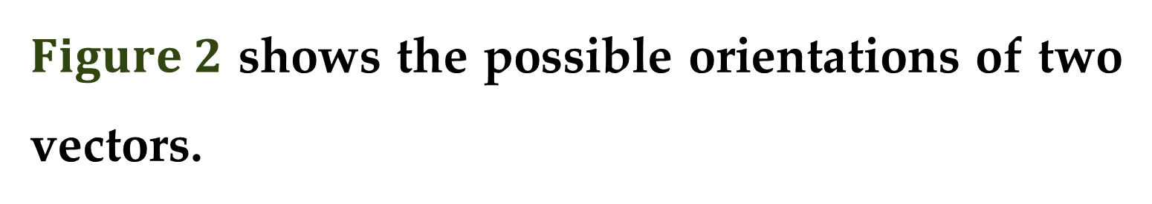
$Figure 2$ shows the possible orientations of two vectors.
From $Theorem 2,$ you can see that two nonzero vectors meet at a right angle if and only if their dot product is zero – two such vectors are said to be $orthogonal$.

Slide 14
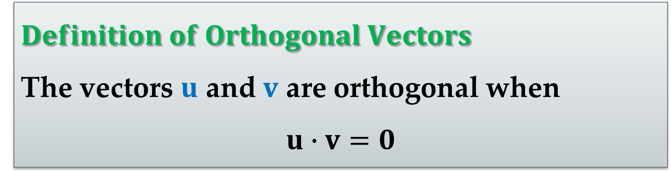
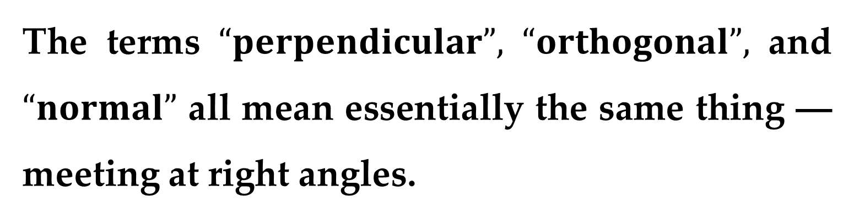
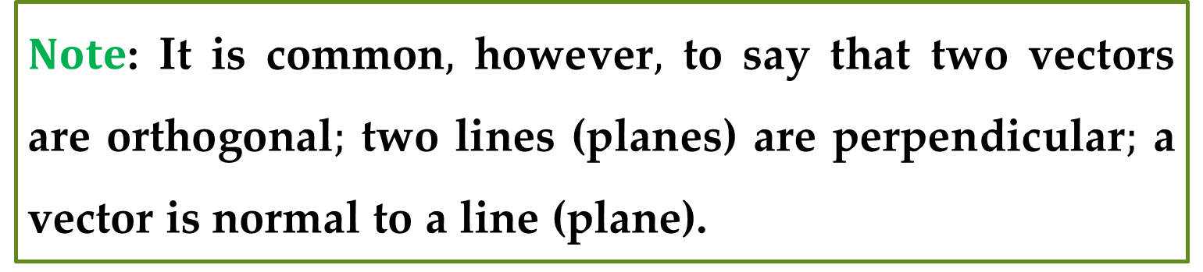
$$Definition of Orthogonal Vectors$$
The vectors $u$ and $v$ are orthogonal when
$$u∙v=0$$
The terms $“perpendicular”,$ $“orthogonal”,$ and $“normal”$ all mean essentially the same thing ––meeting at right angles.
$Note$: It is common$,$ however$,$ to say that two vectors are orthogonal$;$ two lines (planes) are perpendicular$;$ a vector is normal to a line (plane).

Slide 15
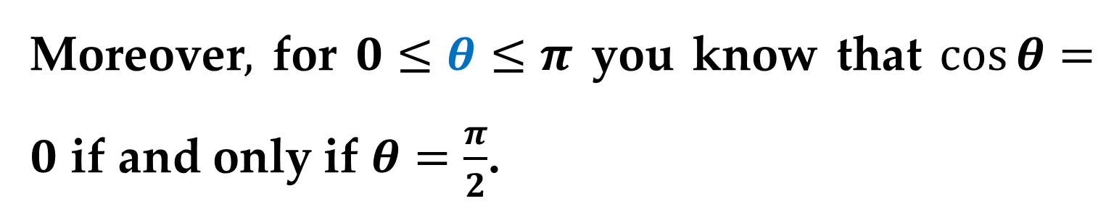
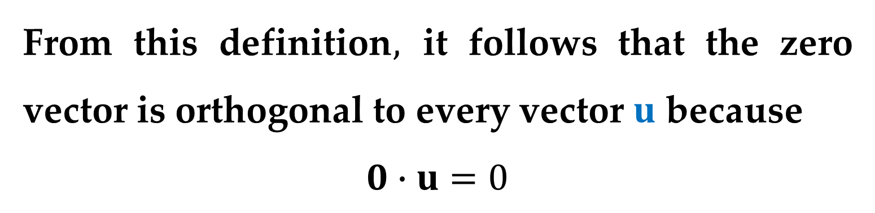
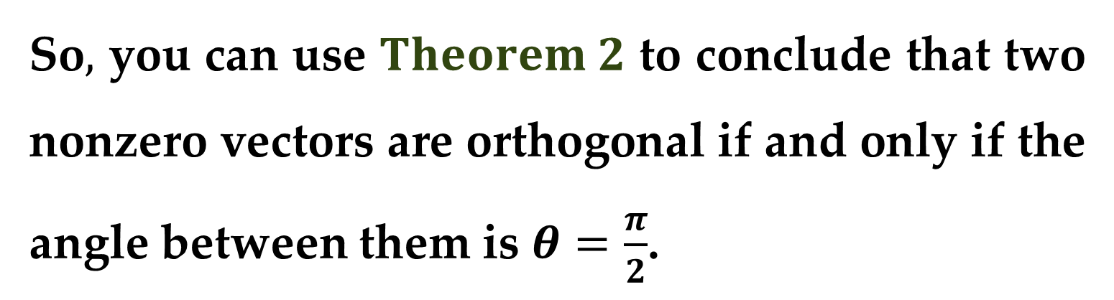
From this definition$,$ it follows that the zero vector is orthogonal to every vector $u$ because
$$0∙u=0$$
Moreover$,$ for $0≤θ≤π$ you know that $\cos{θ}=0$ if and only if $θ=\frac{π}{2}$.
So$,$ you can use $Theorem 2$ to conclude that two nonzero vectors are orthogonal if and only if the angle between them is $θ=\frac{π}{2}$.

Slide 16
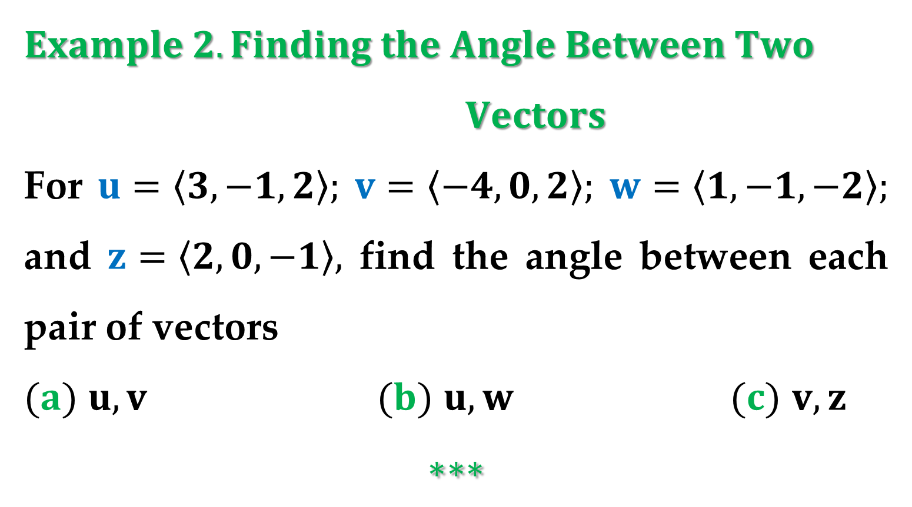
$Example 2. Finding the Angle Between Two$ $Vectors$
For $u=\left\langle 3,−1,2\right\rangle ;$ $v=\left\langle −4,0,2\right\rangle ;$ $w=\left\langle 1,−1,−2\right\rangle ;$ and $z=\left\langle 2,0,−1\right\rangle ,$ find the angle between each pair of vectors
$(a)$ $u, v$ $(b)$ $u,w$ $(c)$ $v, z$
$$∗∗∗$$

Slide 17
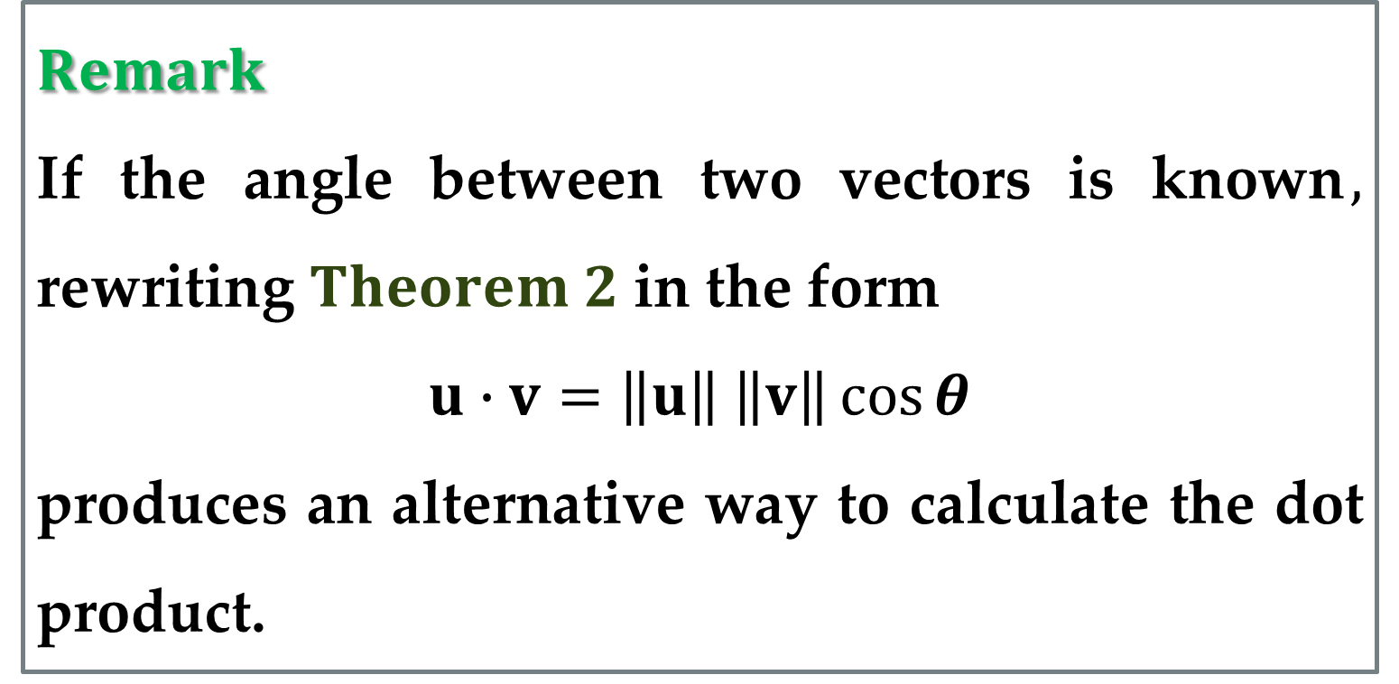
$$Remark$$
If the angle between two vectors is known$,$ rewriting $Theorem 2$ in the form
$$u∙v=\left\|u\right\| \left\|v\right\|\cos{θ}$$
produces an alternative way to calculate the dot product.

Slide 18
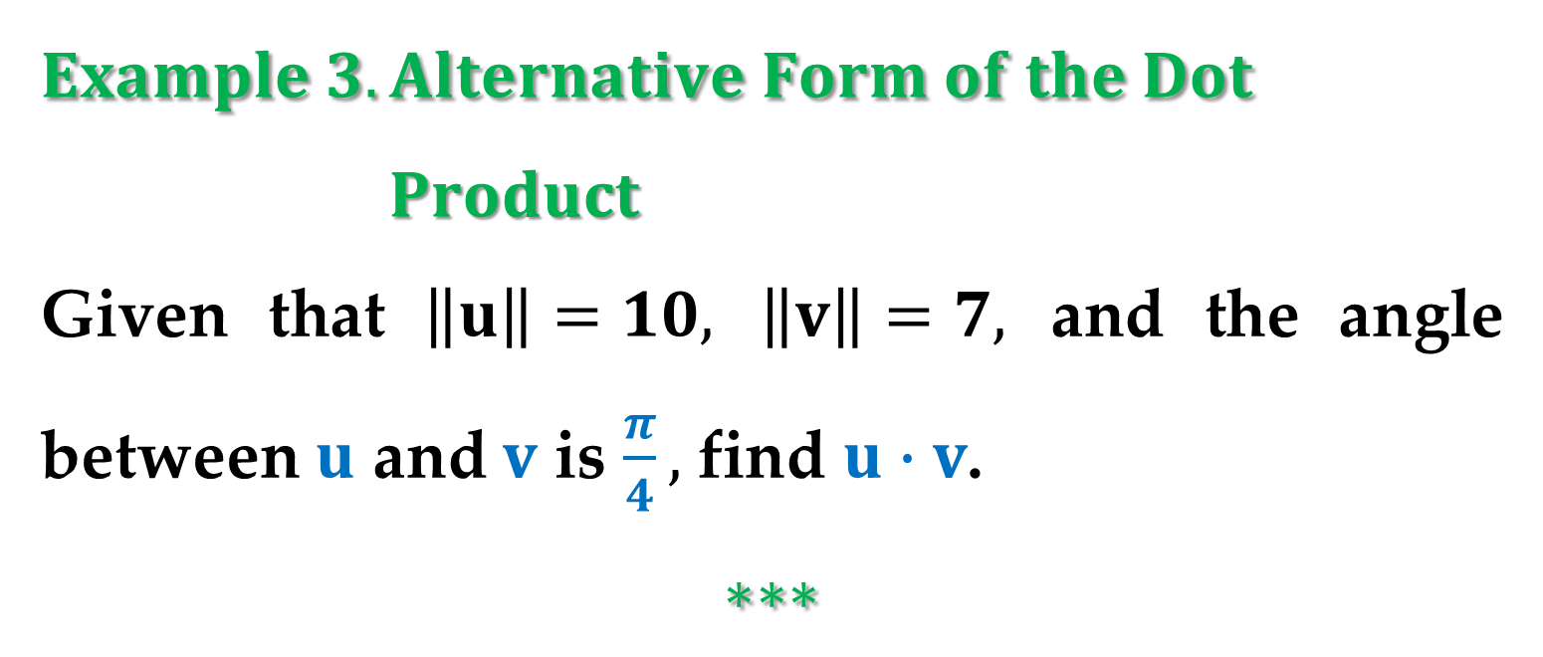
$$Example 3. Alternative Form of the Dot$$
$Product$
Given that $\left\|u\right\|=10,$ $\left\|v\right\|=7,$ and the angle between $u$ and $v$ is $\frac{π}{4},$ find $u∙v$.
$$∗∗∗$$

Slide 19
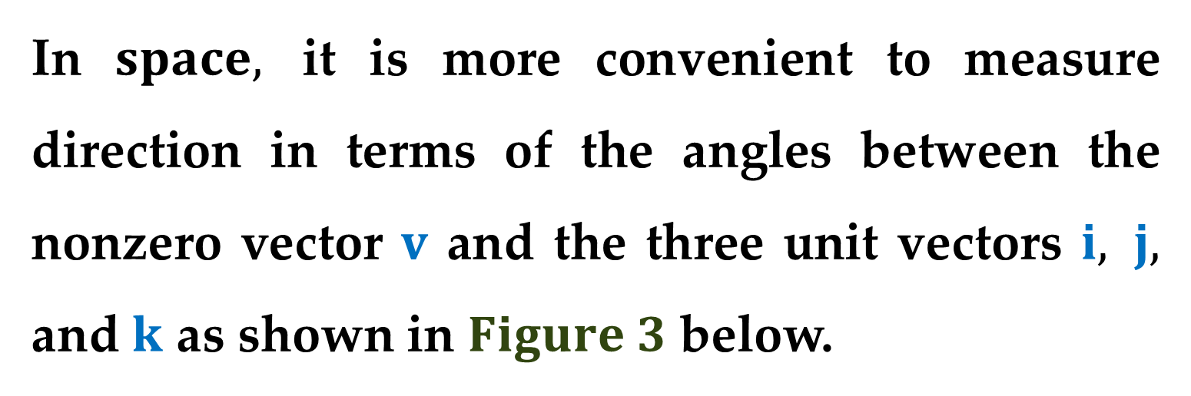
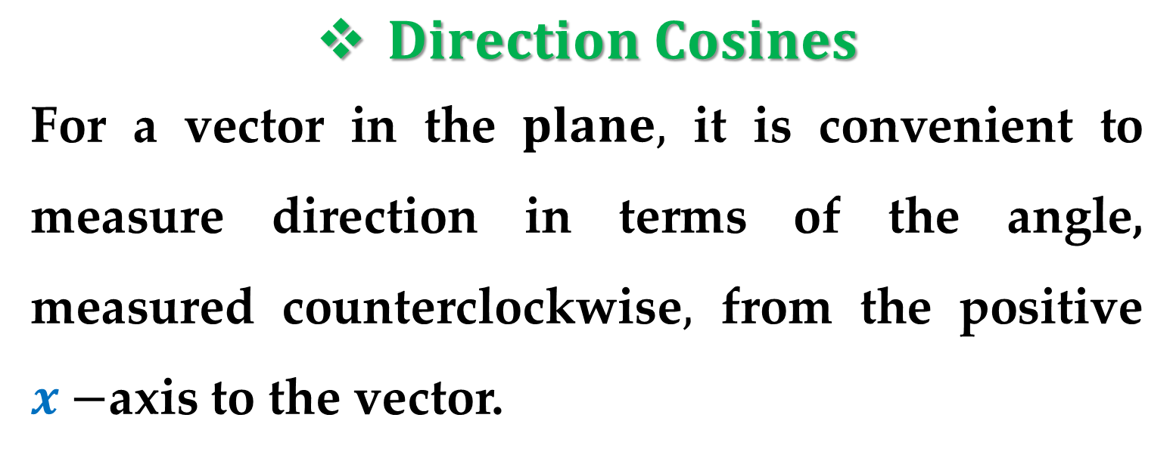
$Direction Cosines$
For a vector in the $plane,$ it is convenient to measure direction in terms of the angle, measured counterclockwise$,$ from the positive $x−$axis to the vector.
In $space,$ it is more convenient to measure direction in terms of the angles between the nonzero vector $v$ and the three unit vectors $i, j,$ and $k$ as shown in $Figure 3$ below.

Slide 20
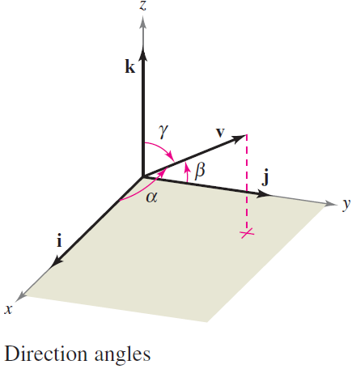
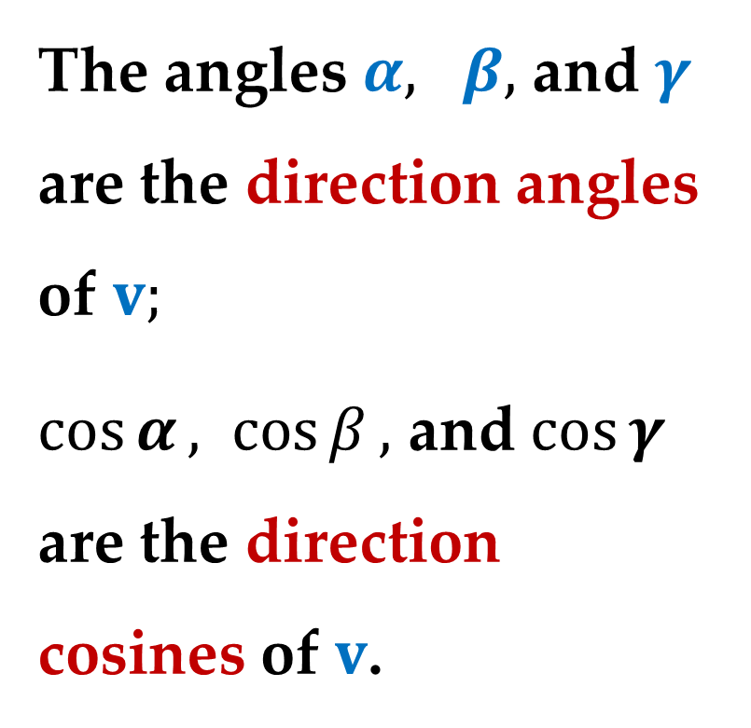
The angles $α, β,$ and $γ$ are the direction angles of $v;$
$\cos{α}, \cos{β},$ and $\cos{γ}$ are the direction cosines of $v$.

Slide 21

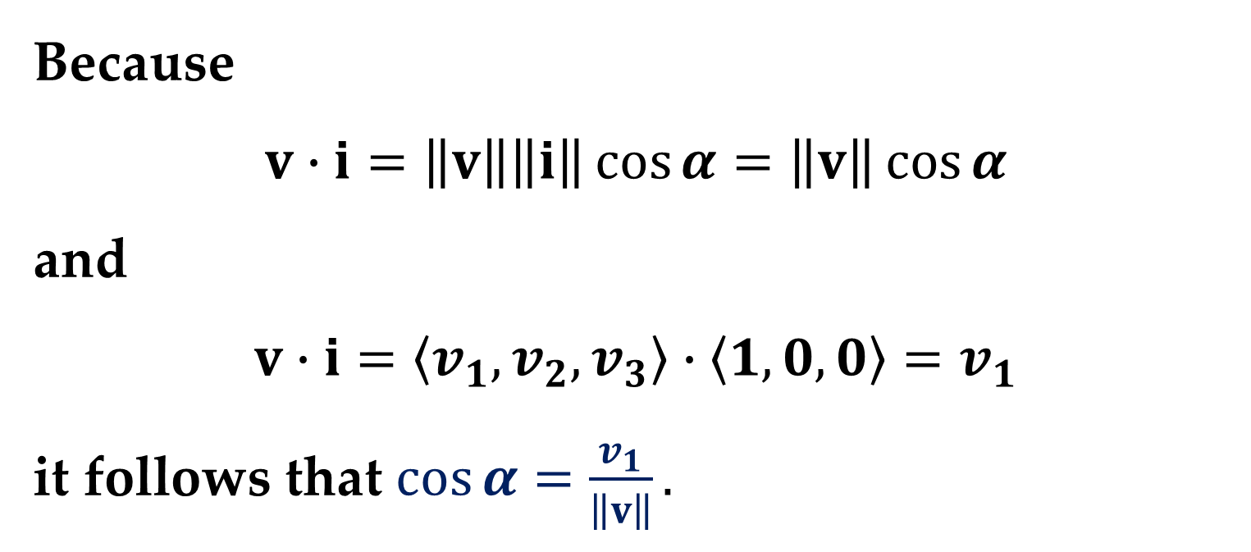
Because
$$v∙i=\left\|v\right\|\left\|i\right\|\cos{α}=\left\|v\right\|\cos{α}$$
and
$$v∙i=\left\langle v_{1},v_{2},v_{3}\right\rangle ∙\left\langle 1,0,0\right\rangle =v_{1}$$
it follows that $\cos{α}=\frac{v_{1}}{\left\|v\right\|}.$
By similar reasoning$,$ we have
$$\cos{α}=v_{1}/\left\|v\right\|$$
$$\cos{β}=v_{2}/\left\|v\right\|$$
$$\cos{γ}=v_{3}/\left\|v\right\|$$

Slide 22

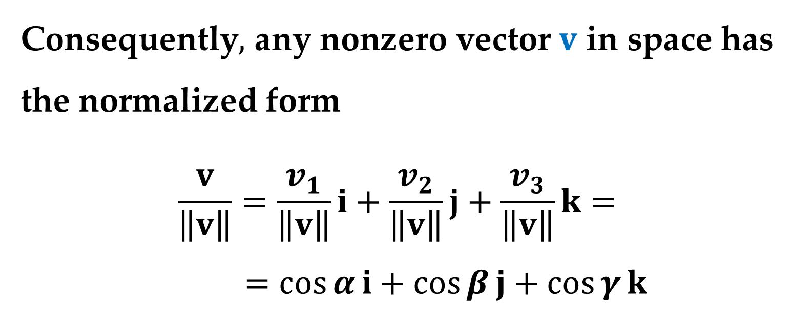
Consequently$,$ any nonzero vector $v$ in space has the normalized form
$$\frac{v}{\left\|v\right\|}=\frac{v_{1}}{\left\|v\right\|}i+\frac{v_{2}}{\left\|v\right\|}j+\frac{v_{3}}{\left\|v\right\|}k=$$
$$=\cos{α}i+\cos{β}j+\cos{γ}k$$
Because $v/\left\|v\right\|$ is a unit vector$,$ it follows that
$$\cos^{2}{α}+\cos^{2}{β}+\cos^{2}{γ}=1$$

Slide 23
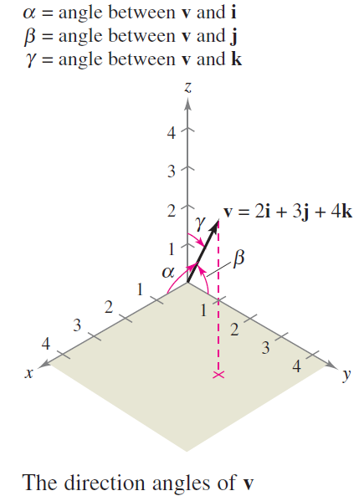
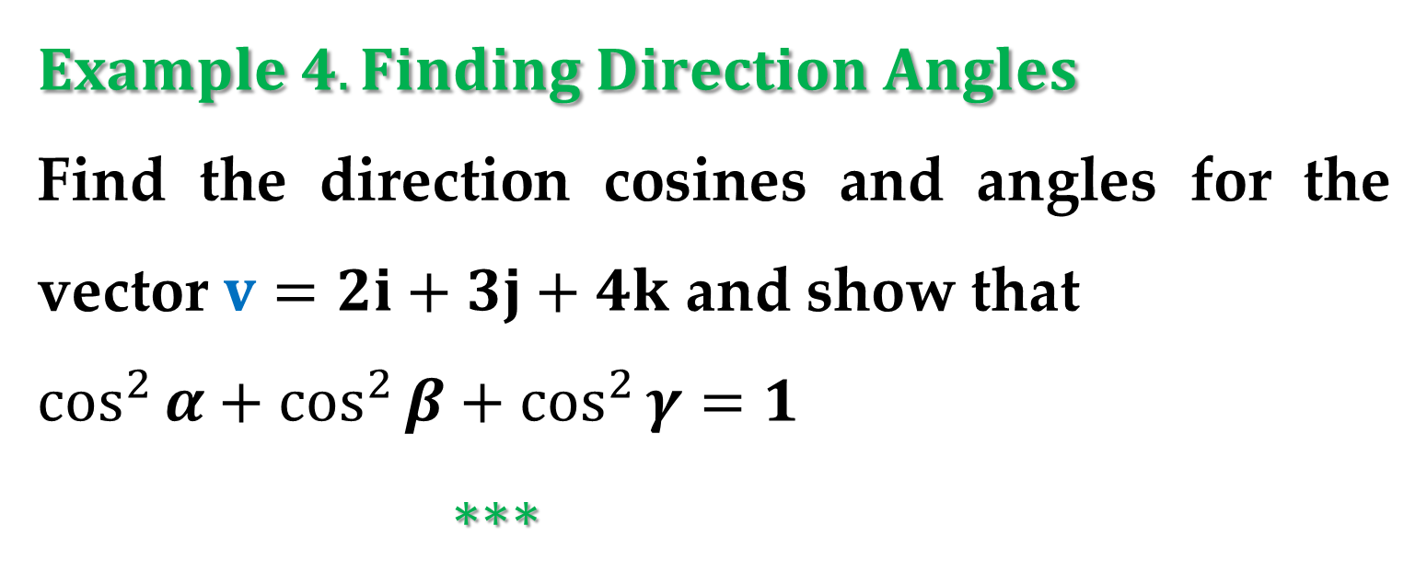
$$Example 4. Finding Direction Angles$$
Find the direction cosines and angles for the vector $v=2i+3j+4k$ and show that
$\cos^{2}{α}+\cos^{2}{β}+\cos^{2}{γ}=1$
$∗∗∗$

Slide 24
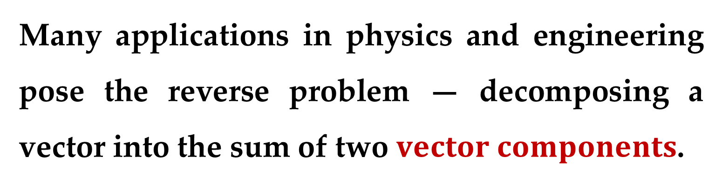
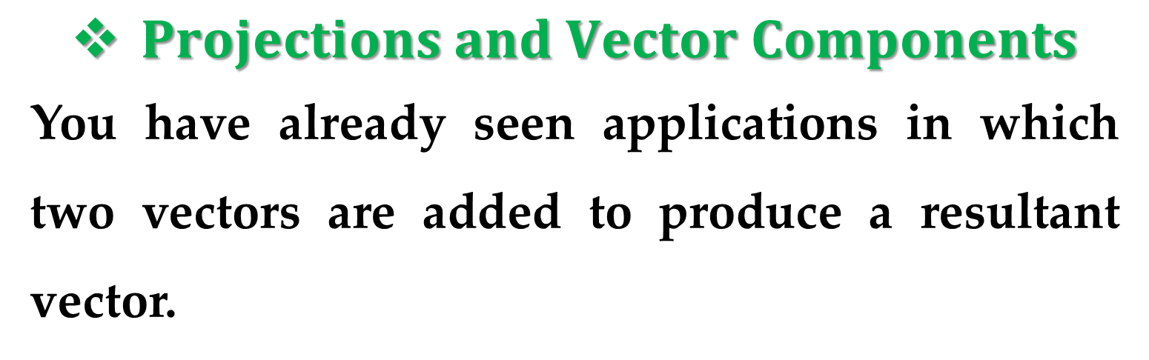
$Projections and Vector Components$
You have already seen applications in which two vectors are added to produce a resultant vector.
Many applications in physics and engineering pose the reverse problem — decomposing a vector into the sum of two $vector components$.
The following physical example enables you to see the usefulness of this procedure.

Slide 25
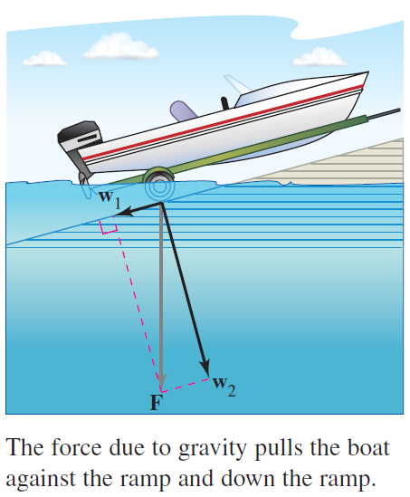
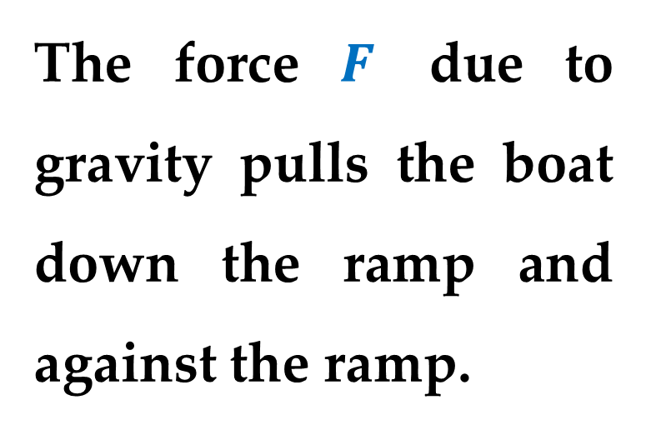
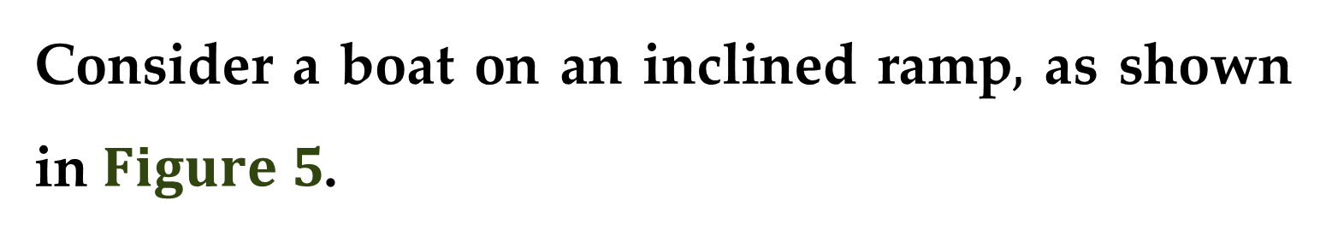
Consider a boat on an inclined ramp$,$ as shown in $Figure 5$.
The force $F$ due to gravity pulls the boat down the ramp and against the ramp.

Slide 26
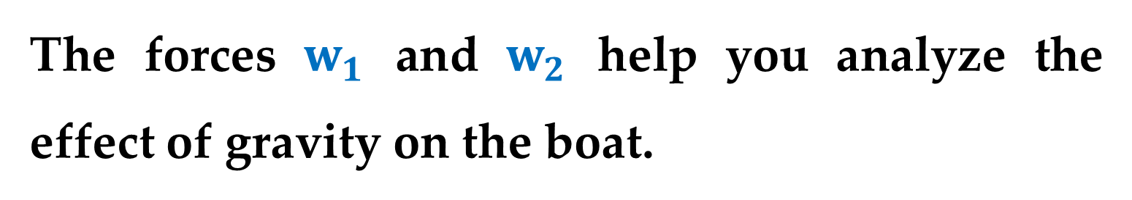
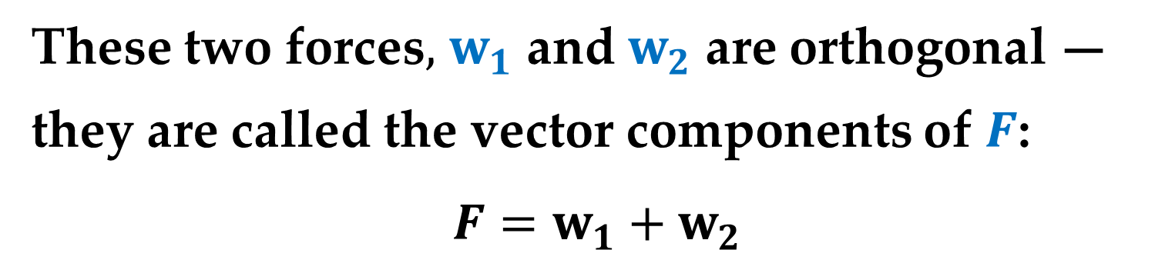
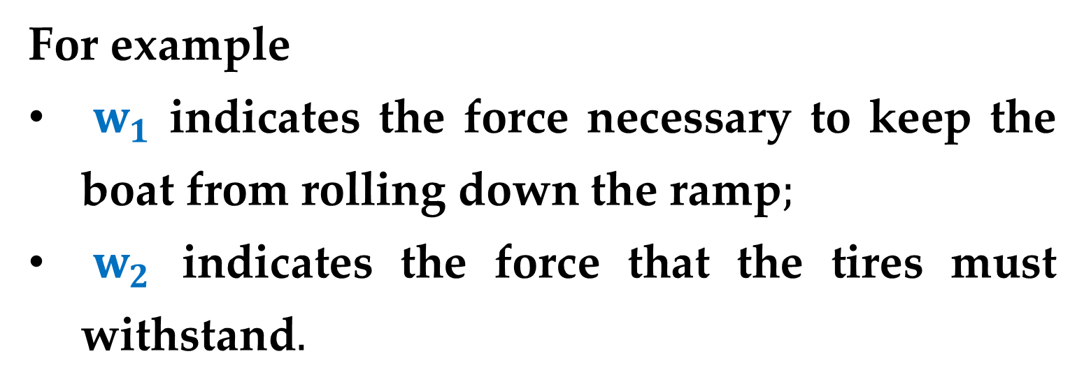
These two forces$,$ $w_{1}$ and $w_{2}$ are orthogonal —
they are called the vector components of $F$:
$$F=w_{1}+w_{2}$$
The forces $w_{1}$ and $w_{2}$ help you analyze the effect of gravity on the boat.
For example
$w_{1}$ indicates the force necessary to keep the boat from rolling down the ramp$;$
$w_{2}$ indicates the force that the tires must withstand$.$

Slide 27
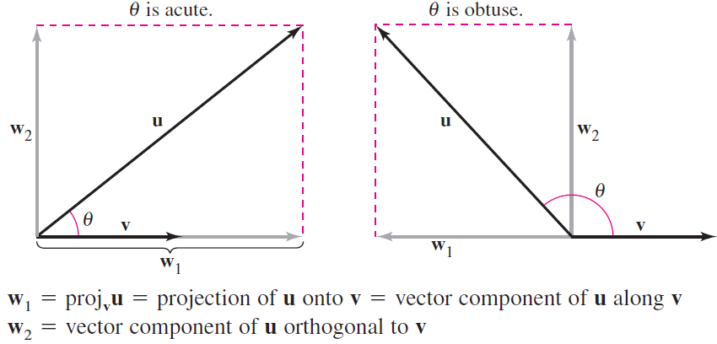
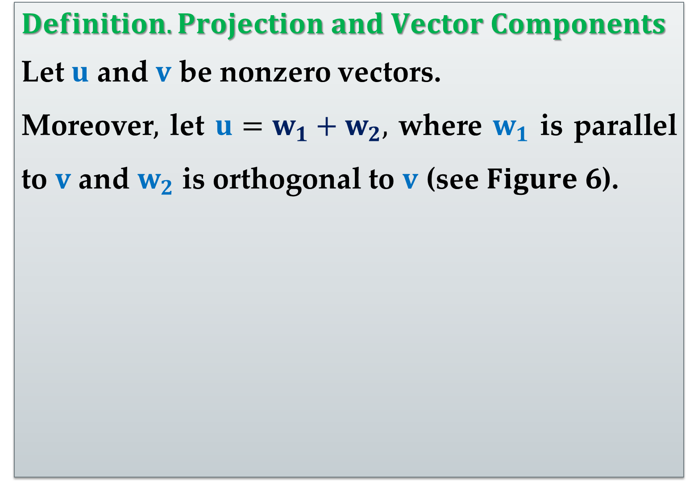
$$Definition. Projection and Vector Components$$
Let $u$ and $v$ be nonzero vectors.
Moreover$,$ let $u=w_{1}+w_{2},$ where $w_{1}$ is parallel to $v$ and $w_{2}$ is orthogonal to $v$ (see $Figure 6$).

Slide 28
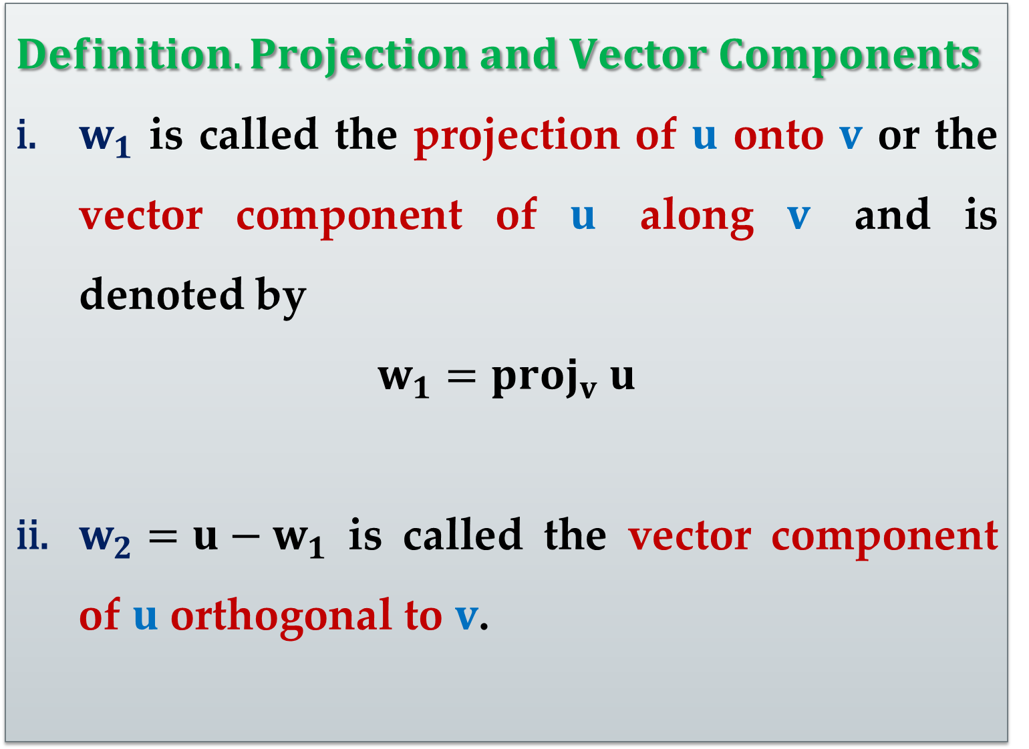
$$Definition. Projection and Vector Components$$
$w_{1}$ is called the projection of $u$ onto $v$ or the vector component of $u$ along $v$ and is denoted by
$$w_{1}={proj}_{v} u$$
$w_{2}=u−w_{1}$ is called the vector component of $u$ orthogonal to $v$.

Slide 29
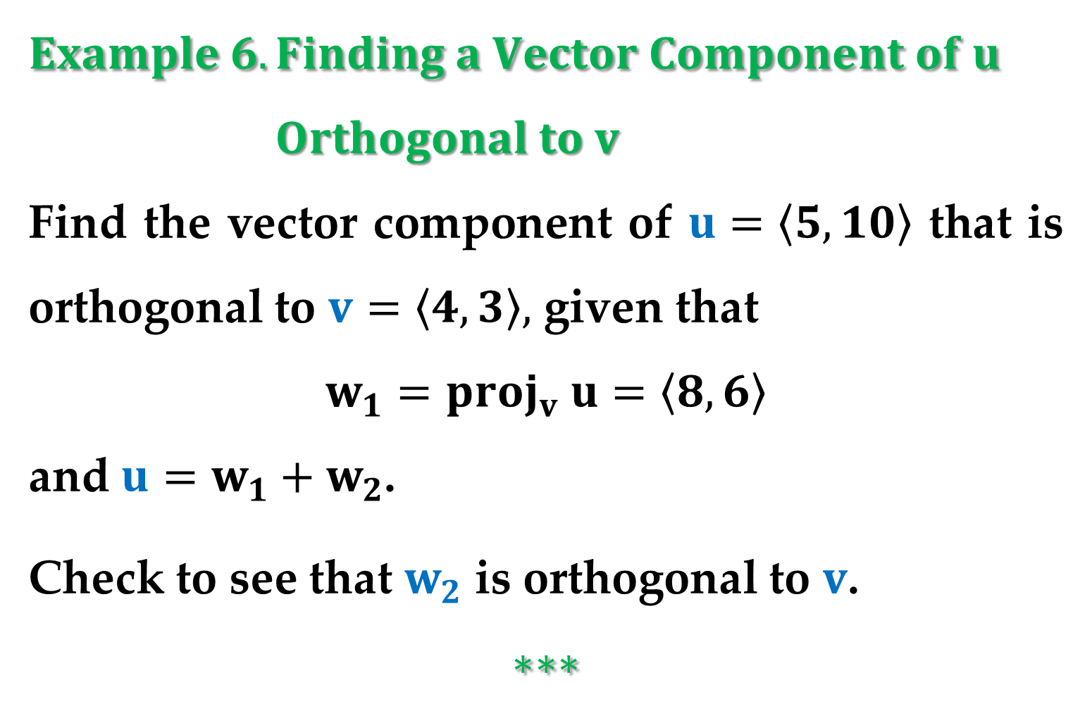
$$Example 6. Finding a Vector Component of u$$
$Orthogonal to v$
Find the vector component of $u=\left\langle 5,10\right\rangle$ that is orthogonal to $v=\left\langle 4,3\right\rangle ,$ given that
$$w_{1}={proj}_{v} u=\left\langle 8,6\right\rangle$$
and $u=w_{1}+w_{2}$.
Check to see that $w_{2}$ is orthogonal to $v$.
$$∗∗∗$$

Slide 30



From $Example 6,$ you can see that it is easy to find the vector component $w_{2}$ once you have found the projection $w_{1}$ of $u$ onto $v$.
To find this projection$,$ we use the dot product.
$$Theorem 3. Projection Using the Dot Product$$
If $u$ and $v$ are nonzero vectors, then the projection of $u$ onto $v$ is
$${proj}_{v} u=\left(\frac{u∙v}{{\left\|v\right\|}^{2}}\right)v$$

Slide 31


The projection of $u$ onto $v$ can be written as a scalar multiple of a unit vector in the direction of $v$:
$$\left(\frac{u∙v}{{\left\|v\right\|}^{2}}\right)v=\left(\frac{u∙v}{\left\|v\right\|}\right)\frac{v}{\left\|v\right\|}=\left(k\right)\frac{v}{\left\|v\right\|}$$
The scalar $k$ is called the component of $u$ in the direction of $v$:
$$k=\frac{u∙v}{\left\|v\right\|}=\left\|u\right\|\cos{θ}$$

Slide 32


Remark
Note the distinction between the terms $“component”$ and $“vector component”$.
For example$,$ using the standard unit vectors with $u=u_{1}i+u_{2}j,$ we have
$u_{1}$ is the component of $u$ in the direction of $i;$
$u_{1}i$ is the vector component in the direction of $i.$

Slide 33


$$Example 7. Decomposing a Vector into Vector$$
$Components$
Find the projection of $u$ onto $v$ and the vector component of $u$ orthogonal
to $v$ for
$u=3i−5j+2k$
$v=7i+j−2k$
$∗∗∗$

Slide 34


$$Example 8. Finding a Force$$
A $600−$pound boat sits on a ramp inclined at $30^{o}$ as shown in $Figure 8$.
What force is required to keep the boat from rolling down the ramp?

Slide 35


$$Solution$$
Because the force due to gravity is vertical and downward$,$ you can represent the gravitational force by the vector $F=−600j$.
To find the force required to keep the boat from rolling down the ramp$,$ project $F$ onto a unit vector $v$ in the direction of the ramp:
$$v=\cos{30^{°}}i+\sin{30^{°}}j=\frac{\sqrt{3}}{2}i+\frac{1}{2}j$$

Slide 36



$$Solution (continued)$$
Therefore$,$ the projection of $F$ onto $v$ is
$$w_{1}=proj_{v} F=\left(\frac{F∙v}{{\left\|v\right\|}^{2}}\right)v=\left(F∙v\right)v$$
$$…=\left(−600×\frac{1}{2}\right)v=−300\left(\frac{\sqrt{3}}{2}i+\frac{1}{2}j\right)$$
The magnitude of this force is $300,$ and therefore a force of $300$ pounds is required to keep the boat from rolling down the ramp. ●

Slide 37


$Work$
The work $W$ done by the constant force $F$ acting along the line of motion of an object is given by
$$W=\left(\text{magnitude} \text{of} \text{force}\right) \left(\text{distance}\right)=\left\|F\right\|\left\|\vec{PQ}\right\|$$
as shown in $Figure 9(a)$.

Slide 38

When the constant force $F$ is not directed along the line of motion$,$ you can see from $Figure 9(b)$ that the work $W$ done by the force is
$$W=\left\|proj_{\vec{PQ}} F\right\|\left\|\vec{PQ}\right\|=\cos{θ}\left\|F\right\|\left\|\vec{PQ}\right\|=$$
$$=F∙\vec{PQ}$$
This notion of work is summarized in the next definition (see below).

Slide 39

$$Definition of Work$$
The work $W$ done by a constant force $F$ as its point of application moves along the vector $\vec{PQ}$ is one of the following:
$W=\left\|proj_{\vec{PQ}} F\right\|\left\|\vec{PQ}\right\|$ – Projection Form
$W=F∙\vec{PQ}$ – Dot Product Form

Slide 40



$$Example 9. Finding Work$$
To close a sliding door$,$ a person pulls on a rope with a constant force of $50$ pounds at a constant angle of $60^{°}$ as shown in
$Figure 10$.
Find the work done in moving the door $12$ feet to its closed position.

Slide 41

$$Solution$$
Using a projection$,$ you can calculate the work as follows:
$$W=\left\|proj_{\vec{PQ}} F\right\|\left\|\vec{PQ}\right\|=$$
$$=\cos{60^{°}}\left\|F\right\| \left\|\vec{PQ}\right\|=$$
$$=\frac{1}{2} \left(50\right) \left(12\right)=300 foot−pounds$$

Slide 42
Thank you for attention

